Slide 1


REAL-TIME SAAS NOTICE BOARD WITH CLOUD SYNC
Presented By:
Girija B, 192311044
CSA1523-Cloud Computing and Big Data Analytics for Healthcare Industries

Slide 2
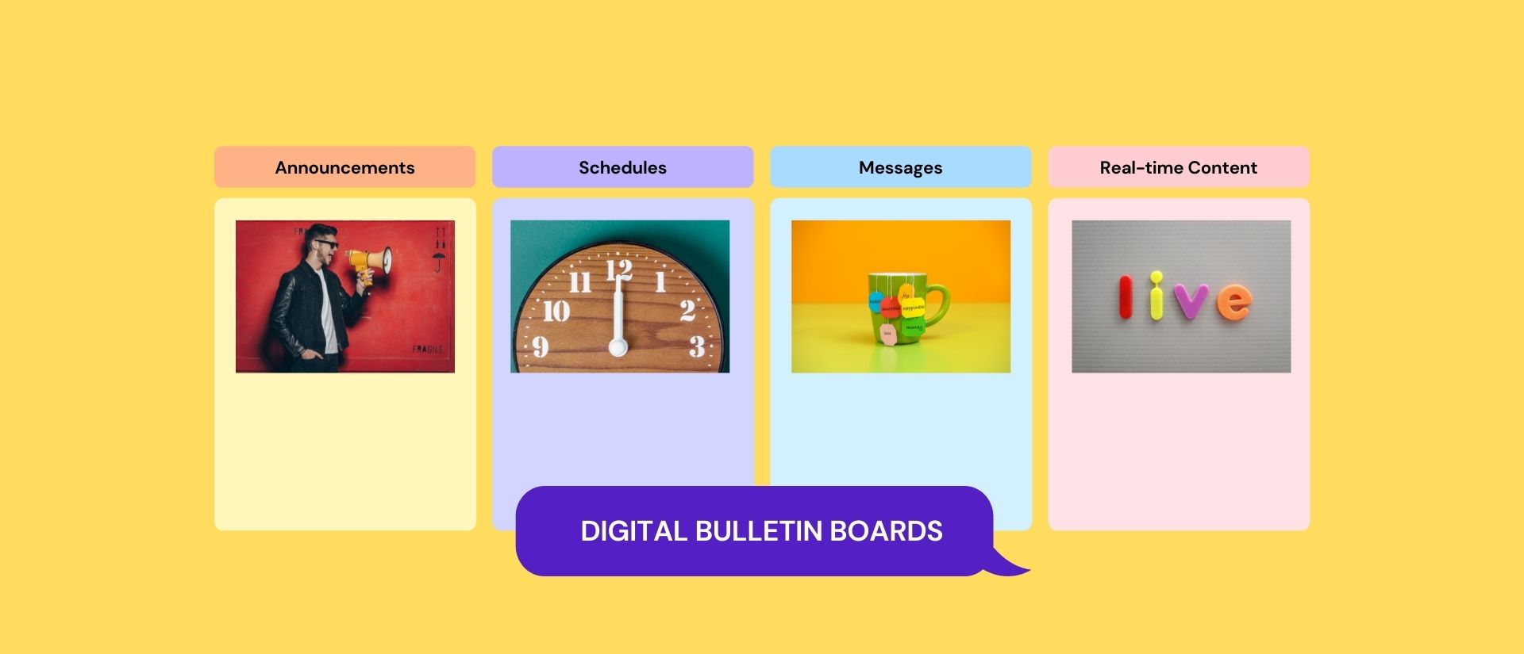
Introduction
Effective communication is crucial for organizations, institutions, and workplaces in today's fast-paced environments. Traditional notice boards rely on manual updates, leading to delays, inefficiency, and limited accessibility.
Our project, SaaS-Based Real-Time Notice Board, offers a modern solution by providing a cloud-based platform where users can sign up, log in, and post notices instantly. Built using Flask (backend) and React (frontend) with Firebase Authentication and Firestore, it ensures secure access and real-time updates.
Key Features:
Secure User Authentication
Real-Time Notice Posting
Cloud-Based Access from Any Device
No Manual Updates Required

Slide 3
Objectives
Define Clear Goals
The SaaS-Based Real-Time Notice Board aims to provide instant, secure, and accessible notice-sharing. Key goals include:
Real-Time Updates – Ensure instant notice posting and visibility.
Secure Access – Implement user authentication for controlled posting.
Cloud-Based Storage – Use Firebase Firestore for centralized, scalable data management.
User-Friendly Interface – Develop an intuitive UI with React.js.
Efficient Backend – Utilize Flask for smooth API handling.
Expected Outcomes
The project aims to develop a real-time, cloud-based notice board with secure user authentication and instant updates. It enhances communication efficiency by allowing users to post notices seamlessly, ensuring accessibility from any device. The system is designed to be scalable, user-friendly, and efficient for various organizations.
Problem statement
Traditional notice boards rely on manual updates, leading to delays, inefficiencies, and limited accessibility. Physical boards require users to be present, while scattered digital messages can cause miscommunication. There is a need for a centralized, cloud-based, real-time notice board that allows authenticated users to post updates instantly, ensuring seamless communication across organizations, educational institutions, and workplaces.

Slide 4
Literature Review / Background
Summary of Existing Research
Existing research highlights the inefficiencies of traditional notice boards, including delays, lack of accessibility, and miscommunication. Studies suggest that cloud-based systems with real-time updates significantly improve information dissemination. Research on SaaS solutions also emphasizes scalability, security, and ease of use, making them ideal for modern notice management.
Theoretical Foundation
Cloud Computing: Enables accessibility and scalability of the notice board.
SaaS Architecture: Allows users to access the system without local installations.
Real-Time Synchronization: Firebase Firestore ensures instant updates and seamless data flow.
Authentication & Security: Firebase Authentication secures user access and prevents unauthorized modifications.
Frontend-Backend Communication: React (frontend) interacts with Flask API (backend) for dynamic content updates.
Research Gap
Despite advancements in digital communication, many organizations still rely on outdated, manually managed notice boards, leading to delays and inefficiencies. Existing solutions often lack real-time updates, centralized access, and secure authentication. This research bridges the gap by developing a cloud-based, SaaS-enabled real-time notice board that ensures instant updates, accessibility, and secure user management, improving communication and efficiency.

Slide 5
Methodology
Development Approach
Requirement Analysis: Identify key features like user authentication and real-time notice posting.
System Design: Define frontend (React.js), backend (Flask API), and database (Firestore).
Implementation: Develop UI, integrate Firebase authentication, and set up API endpoints.
Testing & Debugging: Validate authentication, notice posting, and UI responsiveness.
Deployment (Optional - Runs Locally): The system runs on VS Code without cloud deployment.
Tools & Frameworks Used
Frontend: React.js, Firebase SDK, CSS
Backend: Flask,, Firebase Admin SDK
Database & Authentication: Firebase Authentication, Firestore
Development Tools: VS Code, npm, pip

Slide 6
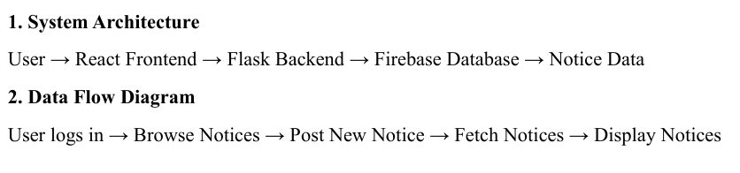
System Design / Architecture
Technology Stack Used
Frontend: React.js, Firebase SDK, Tailwind CSS
Backend: Flask, Flask-CORS, Firebase Admin SDK
Database & Auth: Firestore (NoSQL), Firebase Authentication
Tools: VS Code, Postman, npm, pip
Flowcharts & Block Diagrams
System Architecture
The SaaS-Based Real-Time Notice Board follows a three-tier architecture:
Frontend (React.js): User interface for signup, login, and posting notices.
Backend (Flask API): This handles authentication and data processing.
Database (Firebase Firestore & Authentication): Stores notices and manages user access.

Slide 7
Implementation
Key Features & Functionalities
User Authentication: Secure signup & login using Firebase Authentication.
Real-Time Notice Posting: Instantly publish notices with Firestore database.
Cloud-Based Access: Available from any device with an internet connection.
Secure Data Management: Controlled user access prevents unauthorized modifications.
User-Friendly Interface: Simple and responsive design for easy navigation.
Scalability: Designed to accommodate multiple users efficiently.

Slide 8
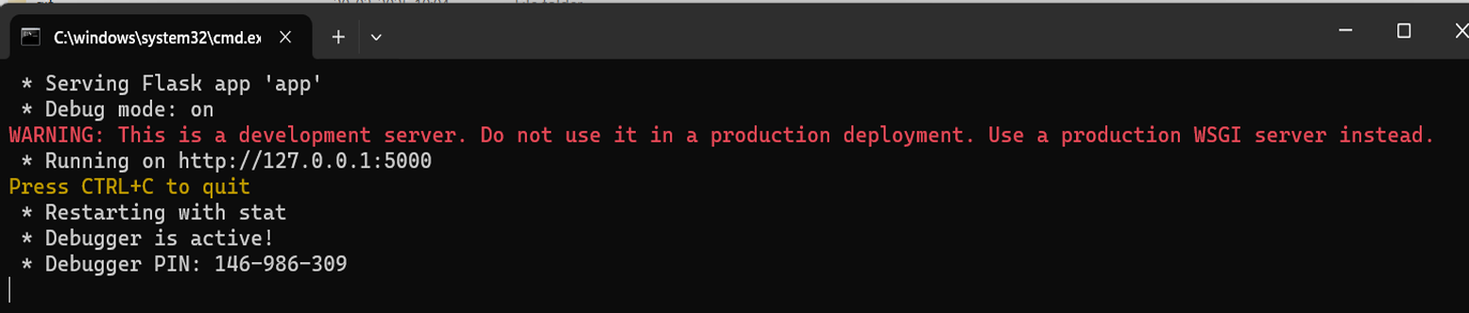
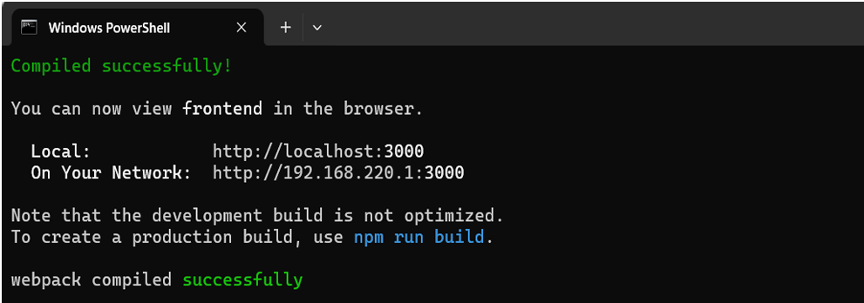
Implementation
Screenshots
Executing Backend (Flask)
Executing Frontend (React)

Slide 9
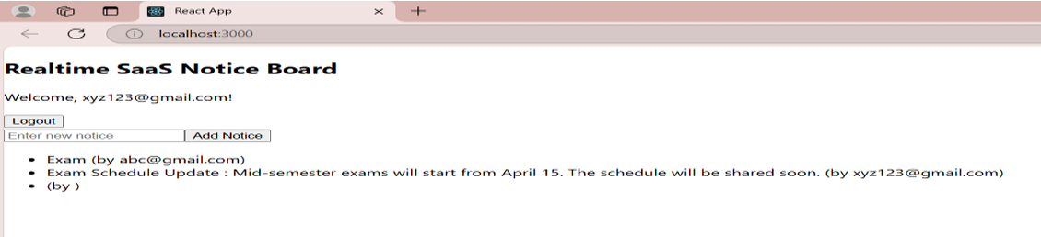
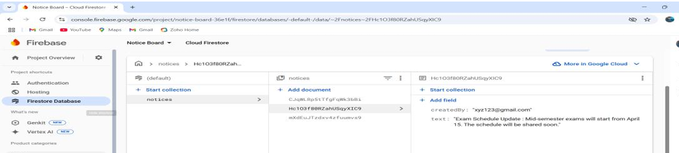
Implementation
Screenshots
Saas Notice Board Web App
Real-Time Monitoring in Firebase Console

Slide 10
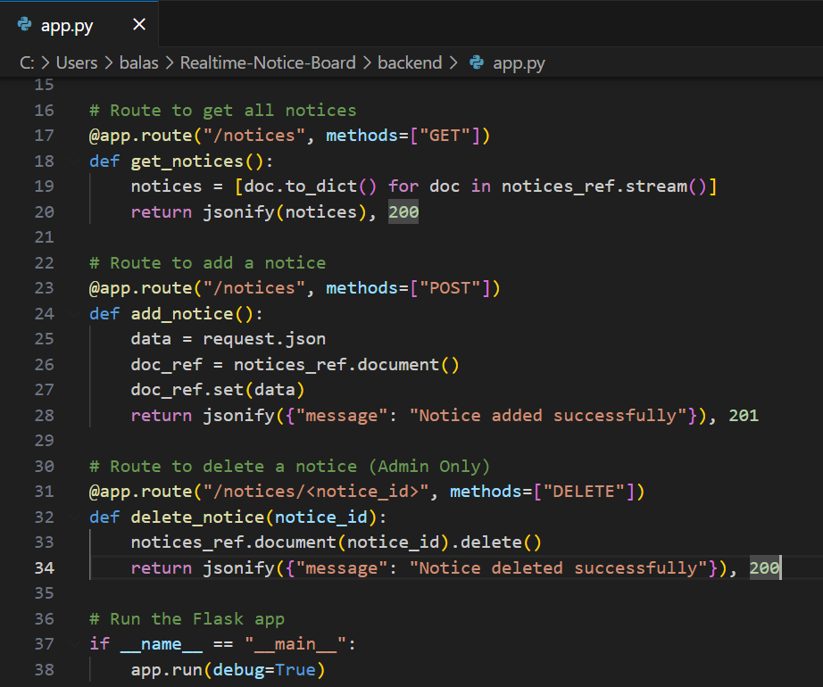
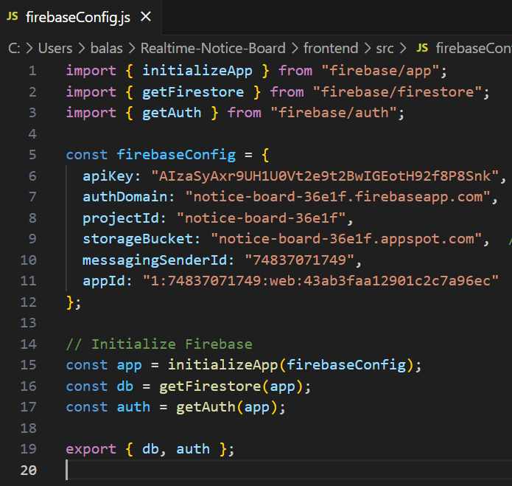
Implementation
Code Snippets
Backend (Flask) – API
Firebase Configuration (React - firebase.js)

Slide 11
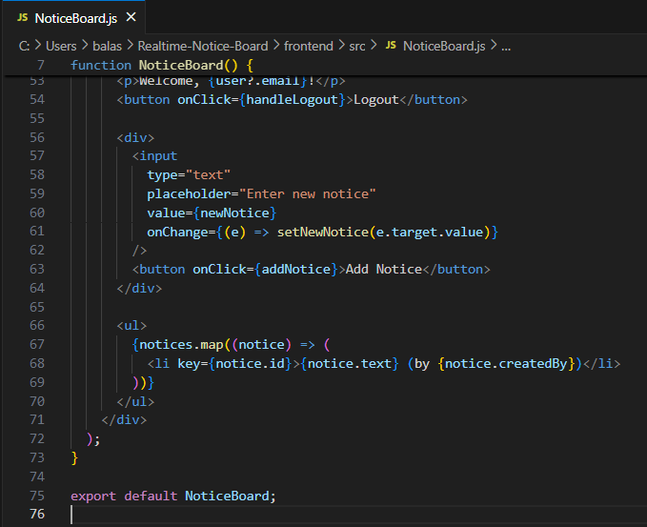
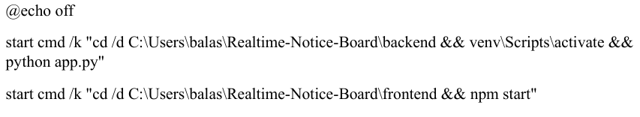
Implementation
Code Snippets
NoticeBoard.js
Execution (run_project.bat)

Slide 12
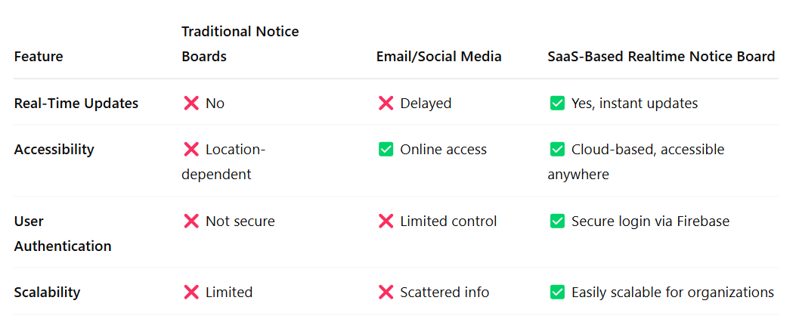
Results & Discussion
Outcomes of the Project
Efficient Notice Management: Eliminates manual updates and delays.
Real-Time Updates: Ensures instant notice delivery to all users.
Improved Accessibility: Users can access notices from anywhere, anytime.
Secure Authentication: Only verified users can post notices.
Scalable Solution: Can be expanded for larger organizations.
User-Friendly Interface: Simplifies notice posting and viewing.
Comparison with Existing Solutions

Slide 13
Challenges & Limitations
Issues Faced During Development
Frontend-Backend Integration: Resolved CORS issues using Flask-CORS.
Authentication Challenges: Configured Firebase Authentication for secure login.
Real-Time Updates: Used Firestore listeners for instant notice updates.
Database Management: Optimized Firestore structure for efficient storage.
UI/UX Issues: Improved responsiveness with Tailwind CSS.
Testing & Debugging: Used Postman for API testing and React DevTools for debugging.
Local Hosting: Managed frontend-backend communication with proper port settings.

Slide 14
Future Scope
Enhancements & Improvements
Admin Controls: Allow admins to delete or pin important notices.
Role-Based Access: Differentiate user roles for better notice management.
Enhanced UI/UX: Improve design with better responsiveness and styling.
Notifications: Implement email or push notifications for new notices.
Search & Filtering: Enable users to search and filter notices easily.
How This Project Can Be Extended
Mobile App Integration – Develop an Android/iOS app for better accessibility.
Multi-Organization Support – Enable different organizations to use a single system with separate notice boards.
Role-Based Access Control – Introduce roles like admin, moderator, and user for better notice management.
Multimedia Notices – Allow users to post images, PDFs, and videos along with text notices.

Slide 15
Conclusion
The SaaS-Based Real-Time Notice Board provides an efficient and scalable solution for modern notice-sharing. By leveraging Flask (backend), React (frontend), and Firebase (authentication & database), the system ensures real-time updates, secure access, and seamless user experience. Unlike traditional notice boards, this cloud-based system enhances accessibility, automation, and instant communication, reducing delays and miscommunication.
The project successfully implements user authentication, notice posting, and real-time updates, making it suitable for educational institutions, corporate offices, and organizations. While the system currently focuses on essential features, it has great potential for future enhancements, such as mobile app integration, role-based access control, multimedia notices, and notification systems.
Overall, this project demonstrates how cloud-based SaaS solutions can revolutionize notice-sharing, making communication more efficient, reliable, and accessible from anywhere.

Slide 16
References
Gupta, A., & Sharma, R. (2021). Enhancing Web-Based Authentication Using Firebase. International Journal of Computer Science and Technology, 12(3), 45-52.
React Team. (2023). React.js Official Documentation. Meta. Available at: https://react.dev/
Grinberg, M. (2018). Flask Web Development: Developing Web Applications with Python. O'Reilly Media.
Amazon Web Services. (2022). SaaS Architecture Best Practices. Available at: https://aws.amazon.com/what-is/saas/
Jones, D., & Patel, S. (2020). Secure User Authentication for Web Applications. IEEE Transactions on Cybersecurity, 18(4), 112-125.

Slide 17
Thank You!

